Slide 1
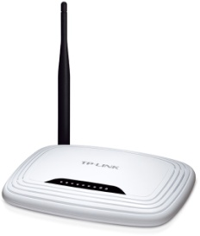
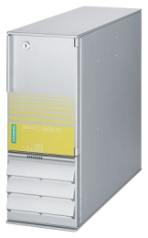
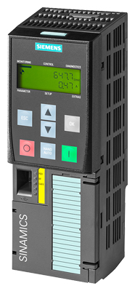
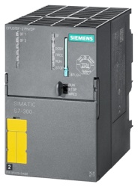
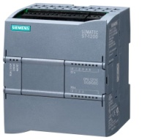
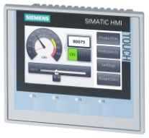
L1
N
PE
TP-LINK
TL-WR741ND
PC
STEP7 / TIA PORTAL
SIZER / STARTER
STARTDRIVE
SINAMICS G120
PM240-2
6SL3210-1PB13-0AL0
L1
L2
L3
PE
SIMATIC S7-300
CPU315F-2PN/DP
6ES7315-2FH13-0AB0
PE
U2
V2
W2
SINAMICS G120
CU250S-2 PN
6SL3246-0BA22-1FA0
U1
M
SIMATIC S7-1200
CPU1211C
6ES7211-1AE40-0XB0
V1
W1
BV
PE
Y ~380V
Инкрементальный
датчик
1XP8012-10 HTL
1024 ppr
1LE1501-0CB32-1AA4
fn = 50 Hz
Pn = 0,37 kW
In = 1,07 A
Cos ϕ = 0,72
n = 1380 rpm
SIMATIC HMI
KTP400 COMFORT
6AV2124-2DC01-0AX0

